Slide 1

Modeling I

Slide 2
Some Dope Quotes
George Box
Mahatma Mario
Doctor Mario
“All models are wrong, but some are useful”
“The best model is the one you don’t have”
“If you can’t be a model, make a model”

Slide 3
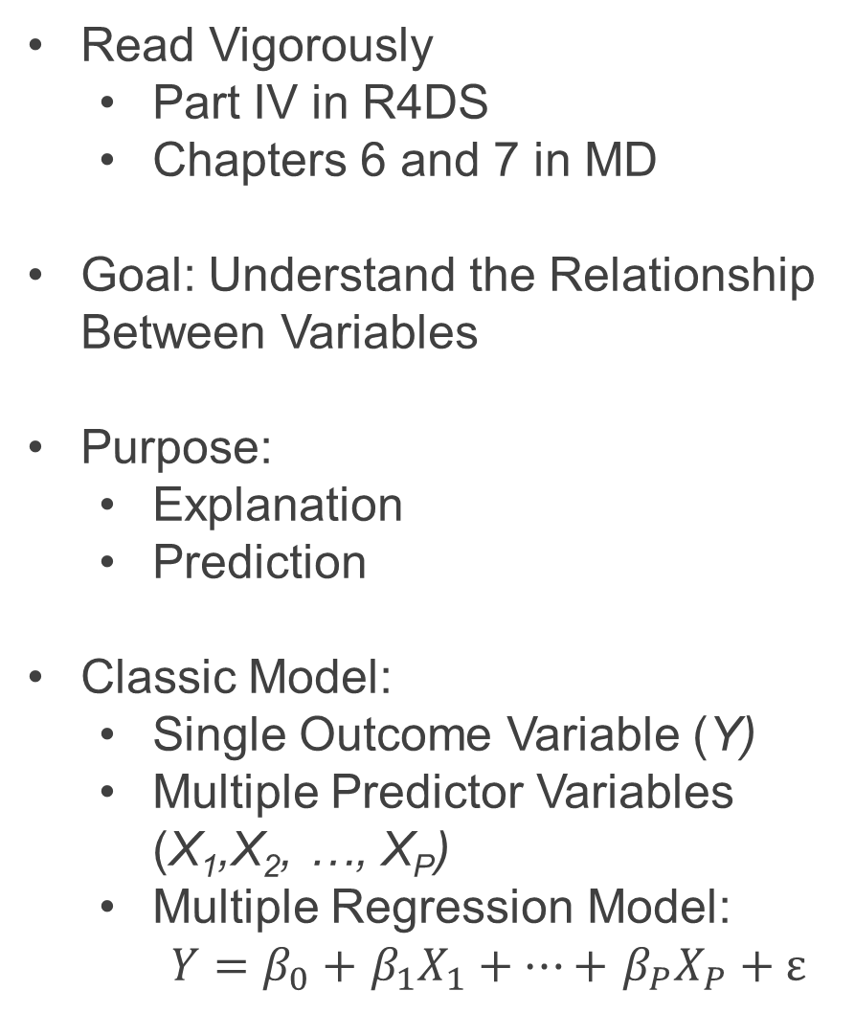
Introduction to Modeling
Read Vigorously
Part IV in R4DS
Chapters 6 and 7 in MD
Goal: Understand the Relationship Between Variables
Purpose:
Explanation
Prediction
Classic Model:
Single Outcome Variable (Y)
Multiple Predictor Variables (X₁,X₂, …, X_{P})
Multiple Regression Model:
$Y=β_{0}+$ $β_{1}X_{1}+…+$ $β_{P}X_{P}+ε$

Slide 4
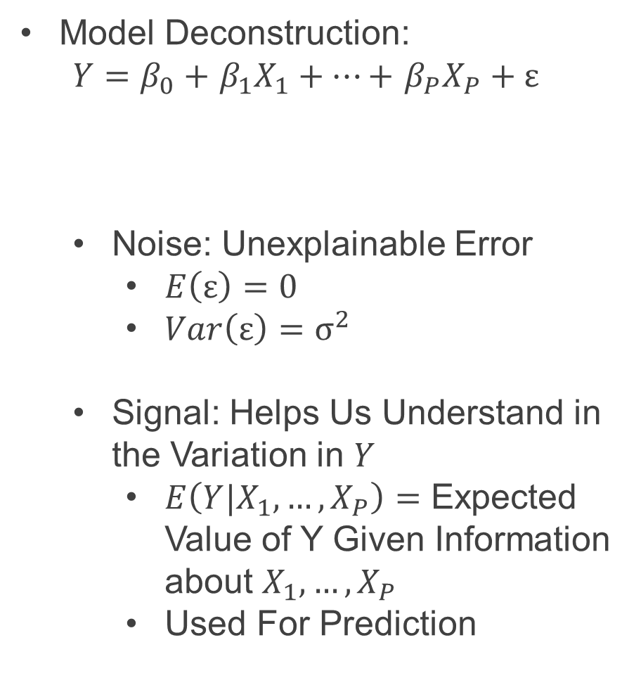
Introduction to Modeling
Model Deconstruction:
$Y=β_{0}+$ $β_{1}X_{1}+…+$ $β_{P}X_{P}+ε$
Noise: Unexplainable Error
$E\left(ε\right)=0$
$Var\left(ε\right)=σ^{2}$
Signal: Helps Us Understand in the Variation in $Y$
$E\left(Y|X_{1},…,X_{P}\right)=$ Expected Value of Y Given Information about $X_{1},…,X_{P}$
Used For Prediction
Signal
Noise

Slide 5
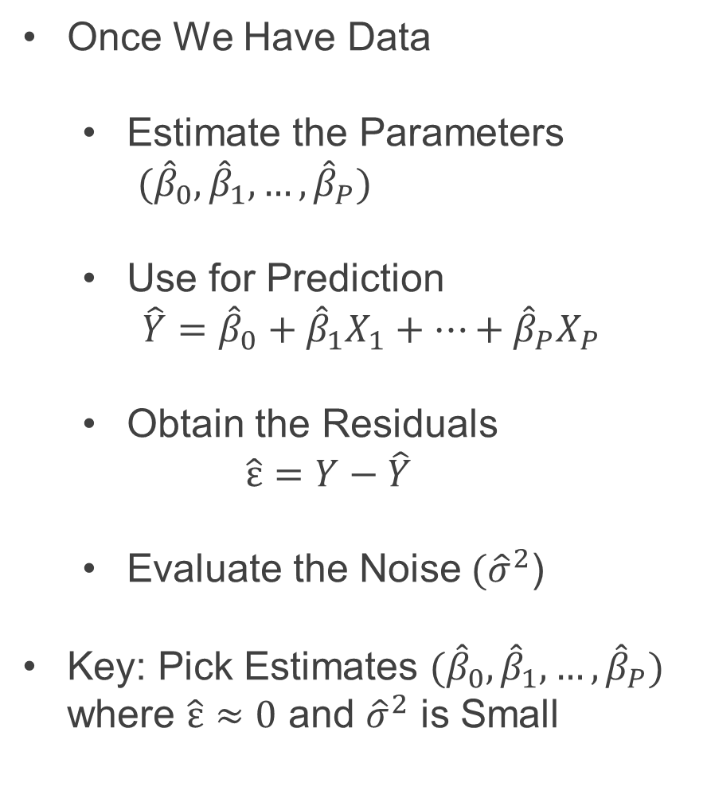
Introduction to Modeling
Once We Have Data
Estimate the Parameters
${(\hat{β}}_{0},{\hat{β}}_{1}, …, {\hat{β}}_{P})$
Use for Prediction
$\hat{Y}={\hat{β}}_{0}+{\hat{β}}_{1}X_{1}+…+{\hat{β}}_{P}X_{P}$
Obtain the Residuals
$$\hat{ε}=Y−\hat{Y}$$
Evaluate the Noise$({\hat{σ}}^{2}$)
Key: Pick Estimates ${(\hat{β}}_{0},{\hat{β}}_{1}, …, {\hat{β}}_{P})$ where $\hat{ε}≈0$ and ${\hat{σ}}^{2}$ is Small

Slide 6
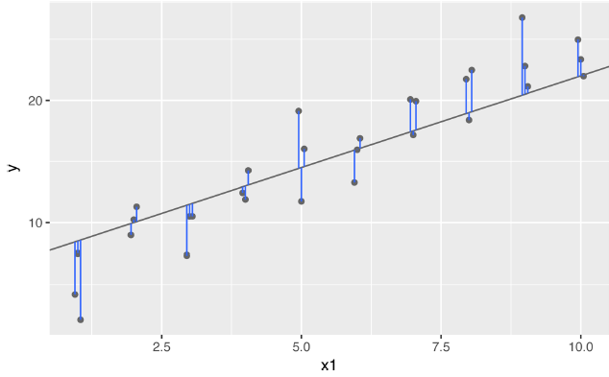
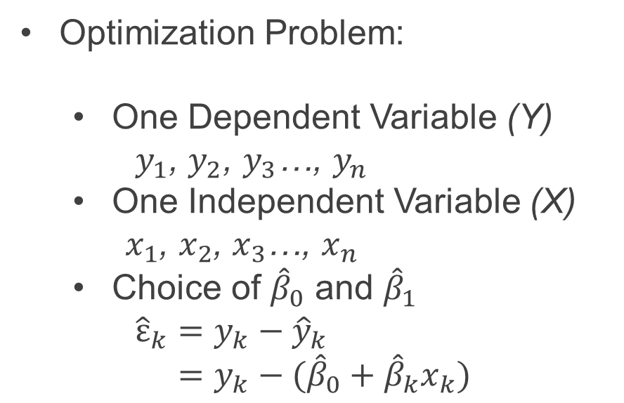
Introduction to Modeling
Optimization Problem:
One Dependent Variable (Y)
$y_{1}$, $y_{2}$, $y_{3}$…, $y_{n}$
One Independent Variable (X)
$x_{1}$, $x_{2}$, $x_{3}$…, $x_{n}$
Choice of ${\hat{β}}_{0}$ and ${\hat{β}}_{1}$
${\hat{ε}}_{k}=y_{k}−{\hat{y}}_{k}$
$=y_{k}−({\hat{β}}_{0}+{\hat{β}}_{k}x_{k})$

Slide 7

Introduction to Modeling
Optimization Problem (Cont.):
Loss Functions:
Sum of Squared Errors $SSE=\sum{{\hat{ε}}_{k}^{2}}$
Mean Squared Error $MSE=\frac{1}{N}\sum{{\hat{ε}}_{k}^{2}}$
Root MSE $RMSE=\sqrt{\frac{1}{N}\sum{{\hat{ε}}_{k}^{2}}}$
Mean Absolute Error $MAE=\frac{1}{N}\sum{\left|{\hat{ε}}_{k}\right|}$

Slide 8
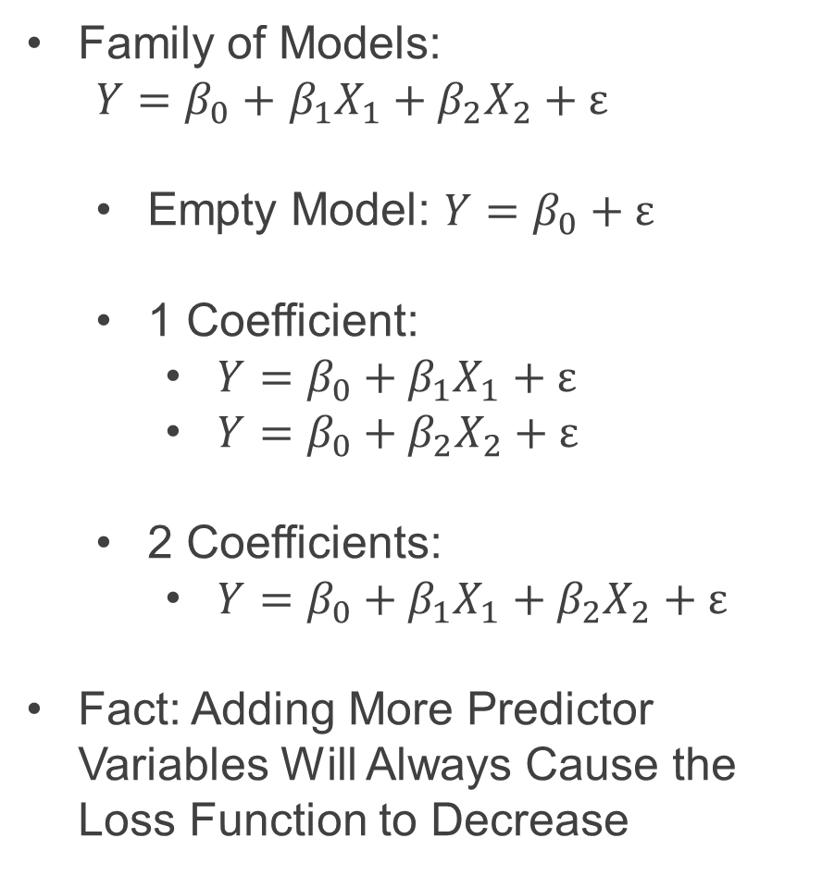
Introduction to Modeling
Family of Models:
$Y=β_{0}+$ $β_{1}X_{1}+β_{2}X_{2}+ε$
Empty Model: $Y=β_{0}+ε$
1 Coefficient:
$Y=β_{0}+β_{1}X_{1}+ε$
$Y=β_{0}+β_{2}X_{2}+ε$
2 Coefficients:
$Y=β_{0}+β_{1}X_{1}+β_{2}X_{2}+ε$
Fact: Adding More Predictor Variables Will Always Cause the Loss Function to Decrease

Slide 9
Introduction to Modeling
Good Practice:
Randomly Split Full Dataset Into Two Datasets
Training Data
80%-90% of Original Data
Used for Model Fitting
Testing Data
20%-10% of Original Data
Used for Model Selection

Slide 10


Motivation
Modeling Real Experimental Data
Question: What Factors Improve Vertical Jump?
Hypothesis 1:
Hypothesis 2:

Slide 11
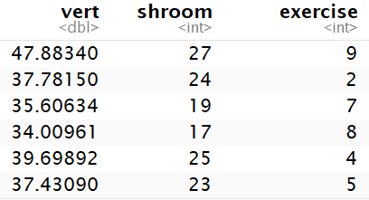
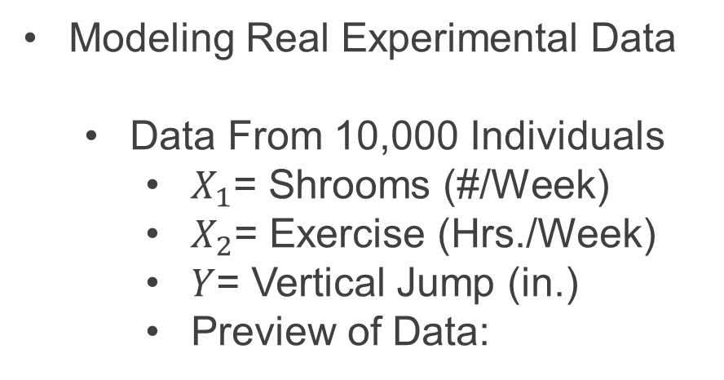
Motivation
Modeling Real Experimental Data
Data From 10,000 Individuals
$X_{1}$= Shrooms (#/Week)
$X_{2}$= Exercise (Hrs./Week)
$Y$= Vertical Jump (in.)
Preview of Data:

Slide 12
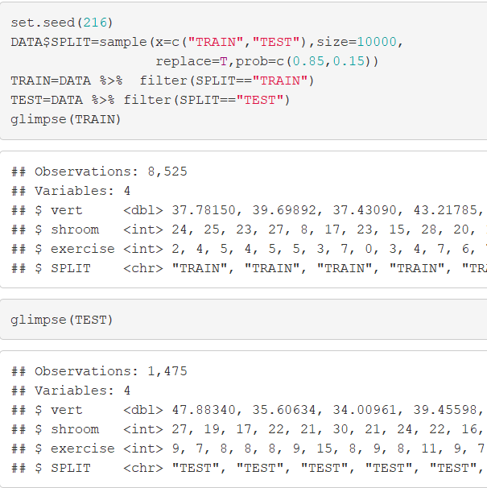
Motivation
Modeling Real Experimental Data
Randomly Split Data

Slide 13
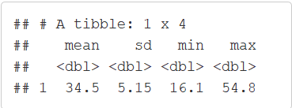
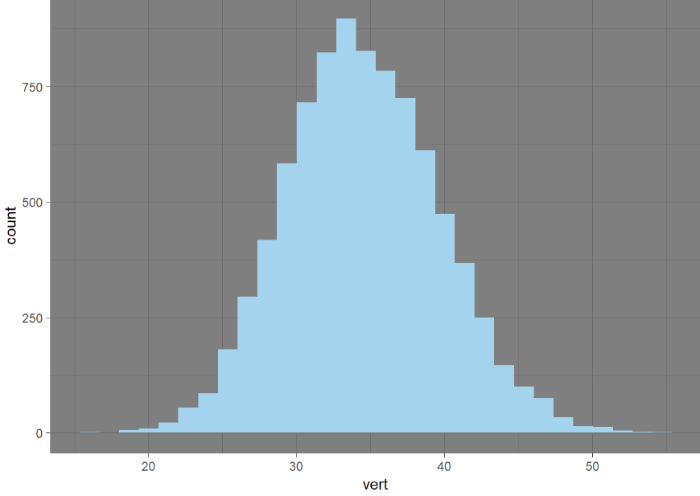
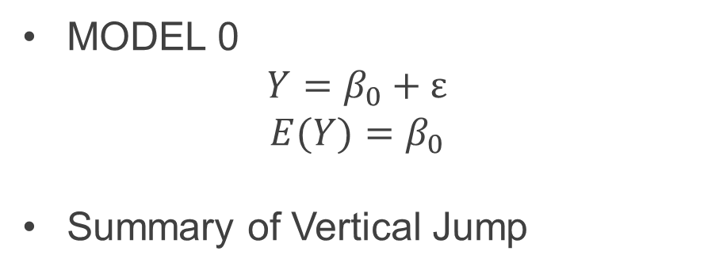
Empty Model (MODEL 0)
MODEL 0
$$Y=β_{0}+ε$$
$$E(Y)=β_{0}$$
Summary of Vertical Jump

Slide 14
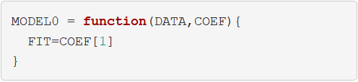
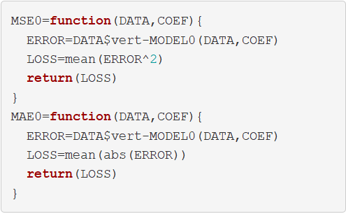
Empty Model (MODEL 0)
Function to Get Fitted Values:
Functions to Evaluate Model:

Slide 15
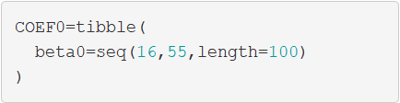
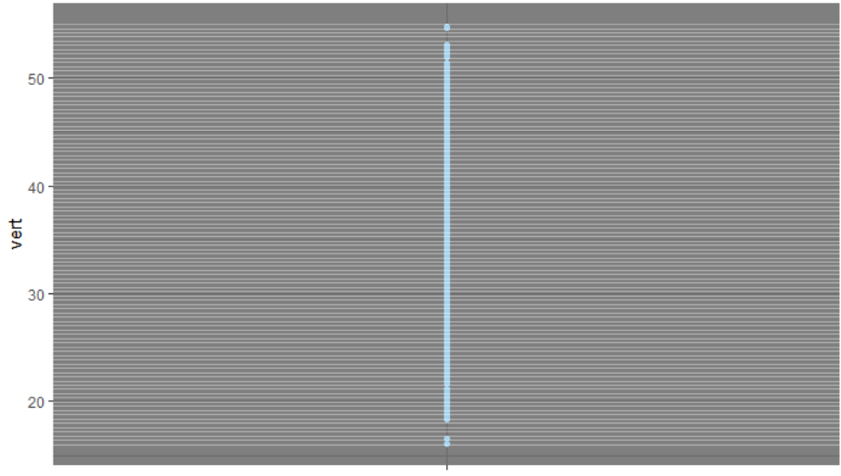

Empty Model (MODEL 0)
Optimization
Specify Possible Values of ${\hat{β}}_{0}$
All Possible Models

Slide 16
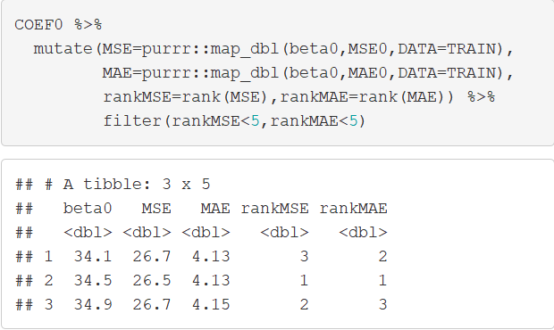

Empty Model (MODEL 0)
Optimization
We Desire to Find the ${\hat{β}}_{0}$ that Minimizes MSE and MAE
map(): purr Package

Slide 17
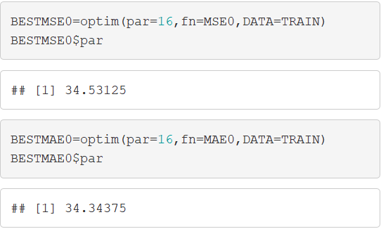
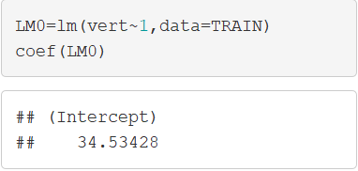
Empty Model (MODEL 0)
Optimization
optim(): Base R
lm(): Base R (Linear Reg)
Starting Values

Slide 18
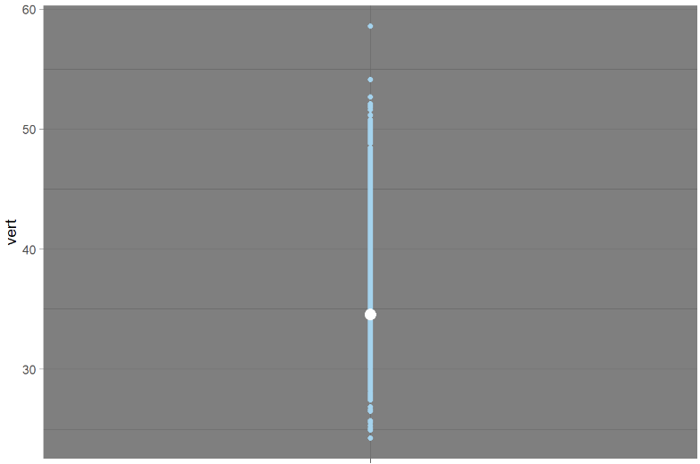
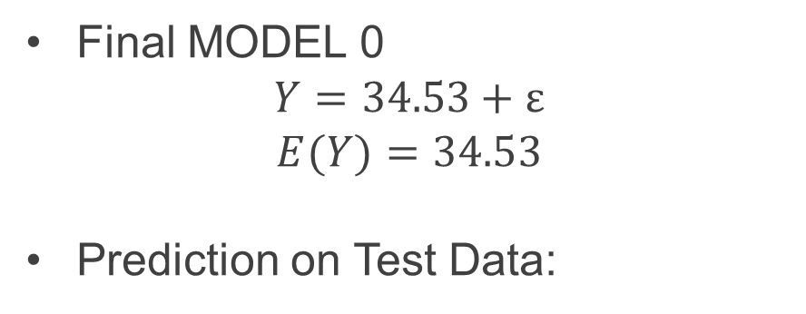
Empty Model (MODEL 0)
Final MODEL 0
$$Y=34.53+ε$$
$$E(Y)=34.53$$
Prediction on Test Data:

Slide 19
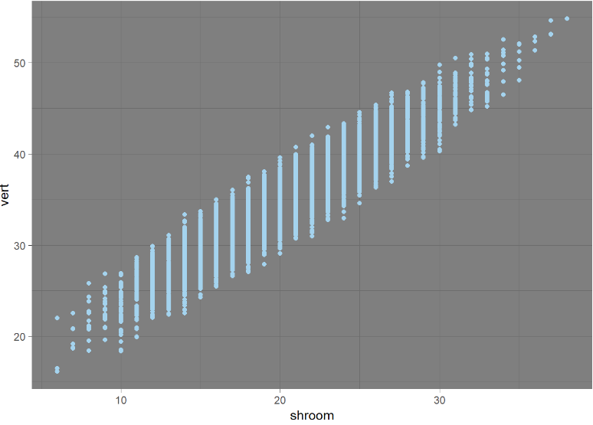
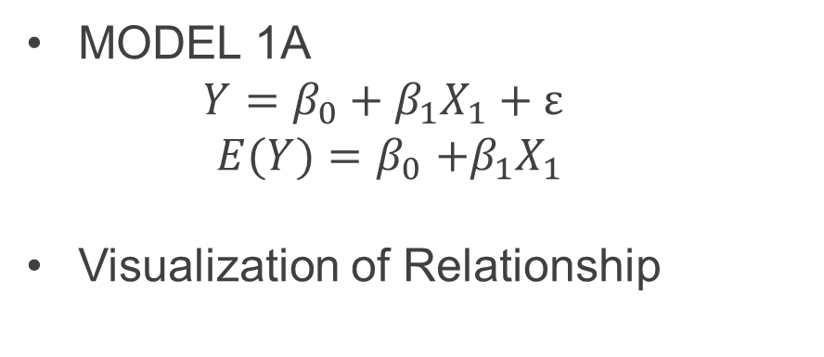
Linear Regression (MODEL 1A & 1B)
MODEL 1A
$$Y=β_{0}+β_{1}X_{1}+ε$$
$E(Y)=β_{0}$ $+β_{1}X_{1}$
Visualization of Relationship

Slide 20
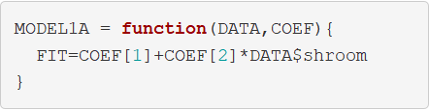
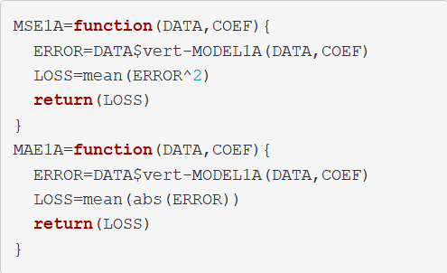
Linear Regression (MODEL 1A & 1B)
Function to Get Fitted Values
Functions to Evaluate Model

Slide 21
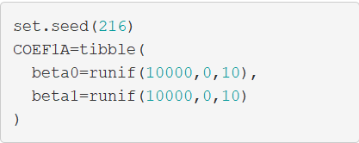
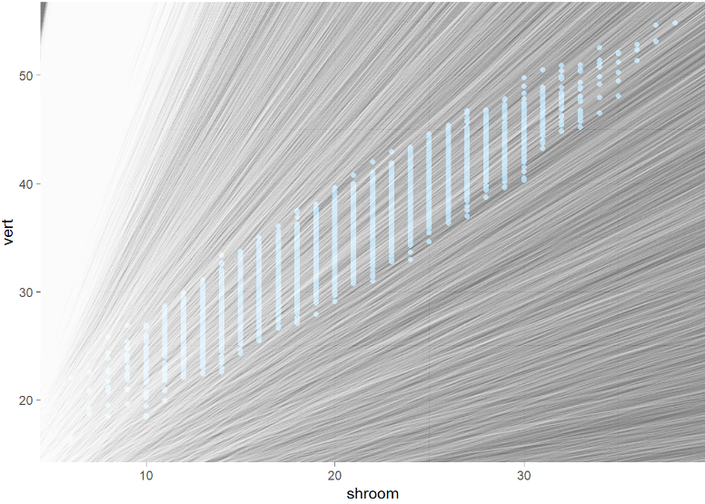
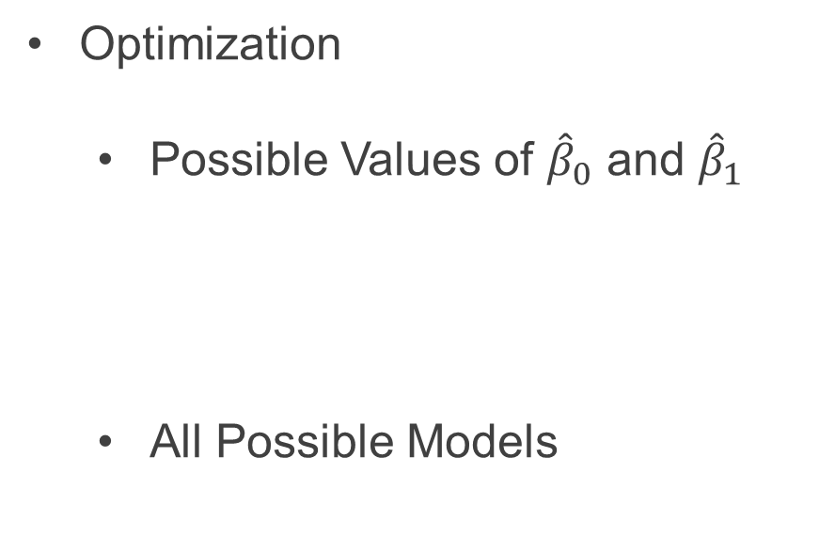
Linear Regression (MODEL 1A & 1B)
Optimization
Possible Values of ${\hat{β}}_{0}$ and ${\hat{β}}_{1}$
All Possible Models

Slide 22
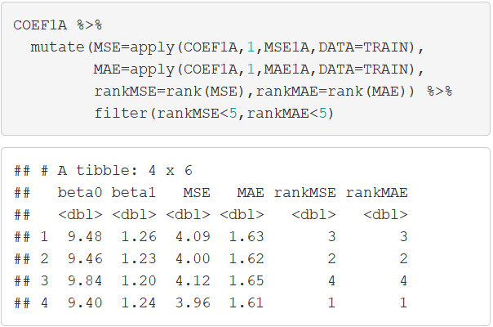
Linear Regression (MODEL 1A & 1B)
Optimization
Use of apply() Function

Slide 23
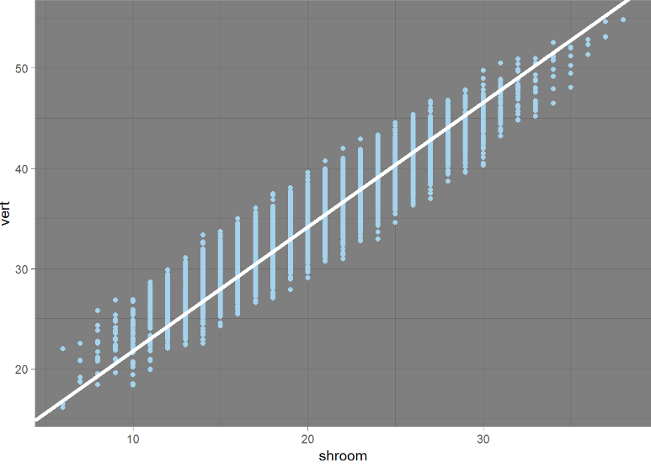
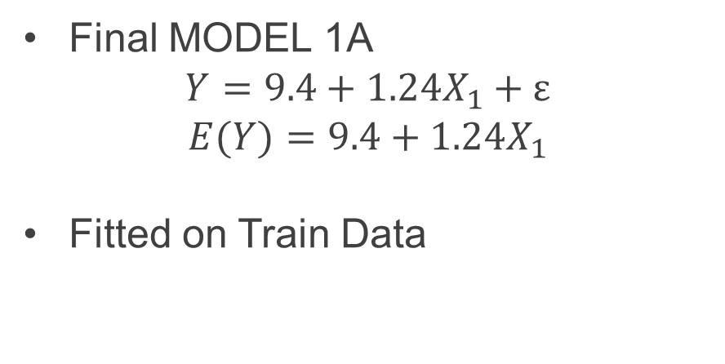
Linear Regression (MODEL 1A & 1B)
Final MODEL 1A
$$Y=9.4+1.24X_{1}+ε$$
$$E(Y)=9.4+1.24X_{1}$$
Fitted on Train Data

Slide 24
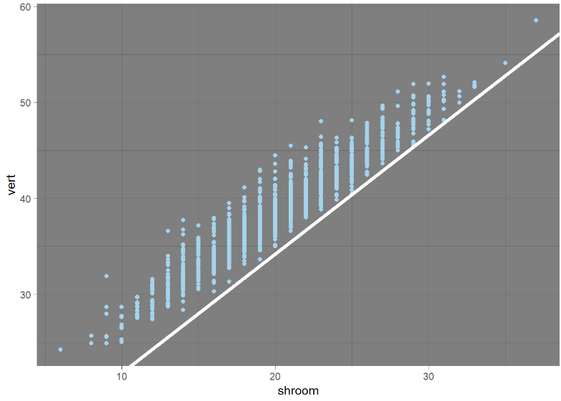
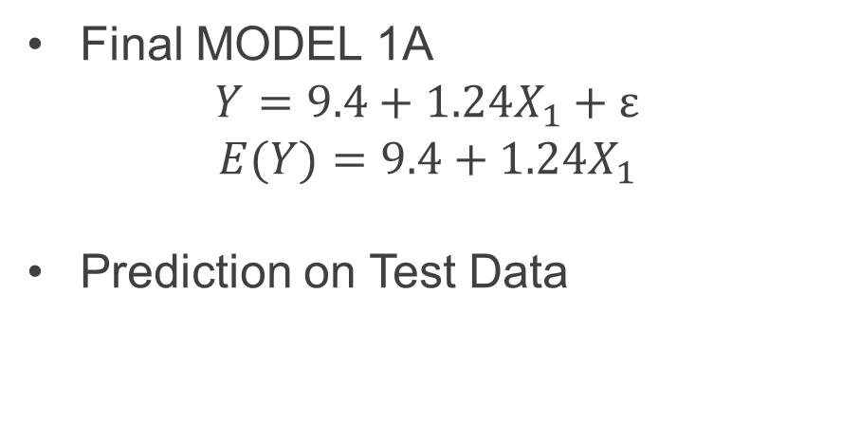
Linear Regression (MODEL 1A & 1B)
Final MODEL 1A
$$Y=9.4+1.24X_{1}+ε$$
$$E(Y)=9.4+1.24X_{1}$$
Prediction on Test Data

Slide 25
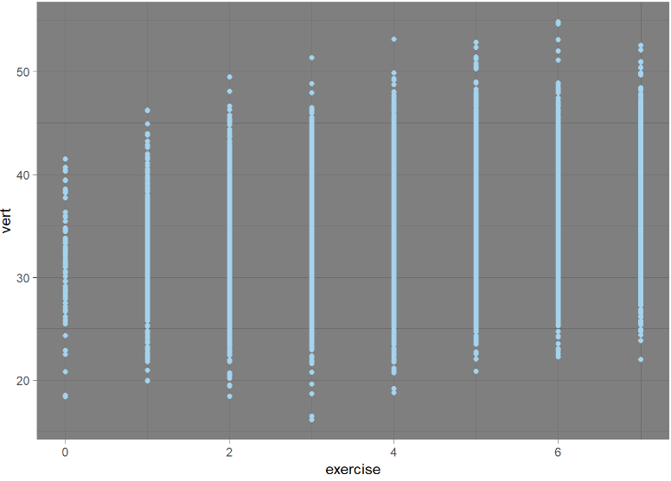
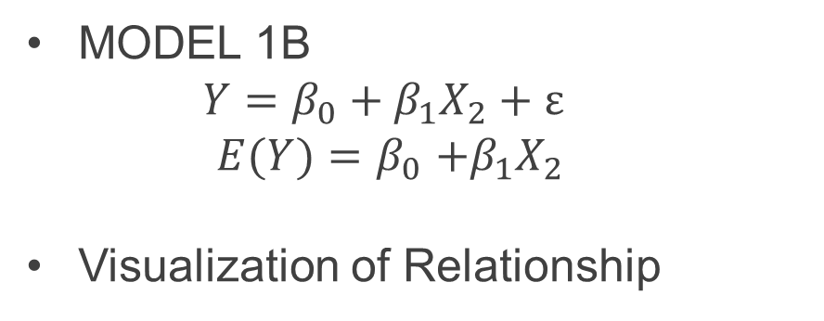
Linear Regression (MODEL 1A & 1B)
MODEL 1B
$$Y=β_{0}+β_{1}X_{2}+ε$$
$E(Y)=β_{0}$ $+β_{1}X_{2}$
Visualization of Relationship

Slide 26
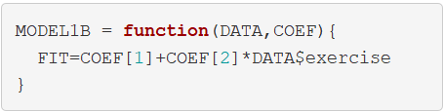
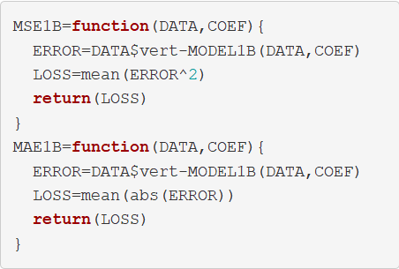
Linear Regression (MODEL 1A & 1B)
Function to Get Fitted Values
Functions to Evaluate Model

Slide 27
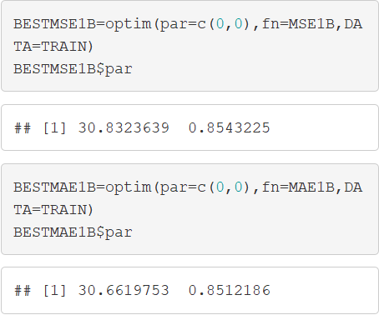
Linear Regression (MODEL 1A & 1B)
Optimization
Use of optim() Function

Slide 28
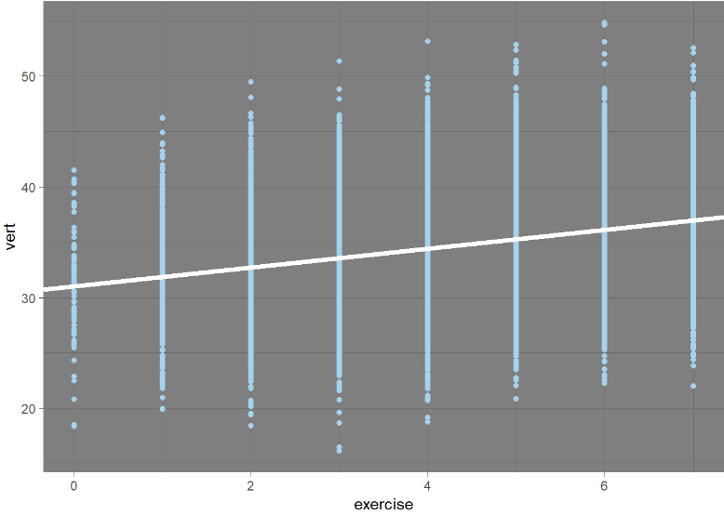
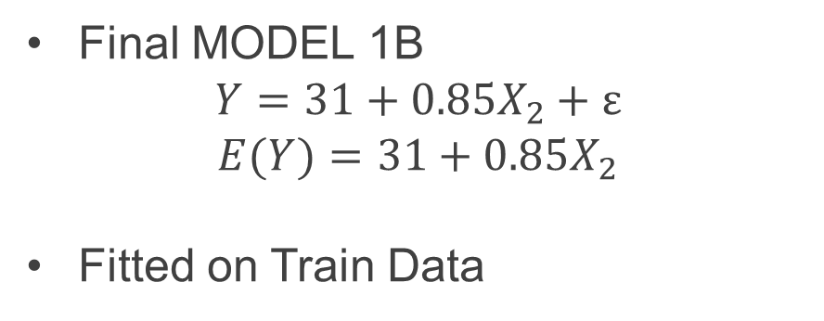
Linear Regression (MODEL 1A & 1B)
Final MODEL 1B
$$Y=31+0.85X_{2}+ε$$
$$E(Y)=31+0.85X_{2}$$
Fitted on Train Data

Slide 29
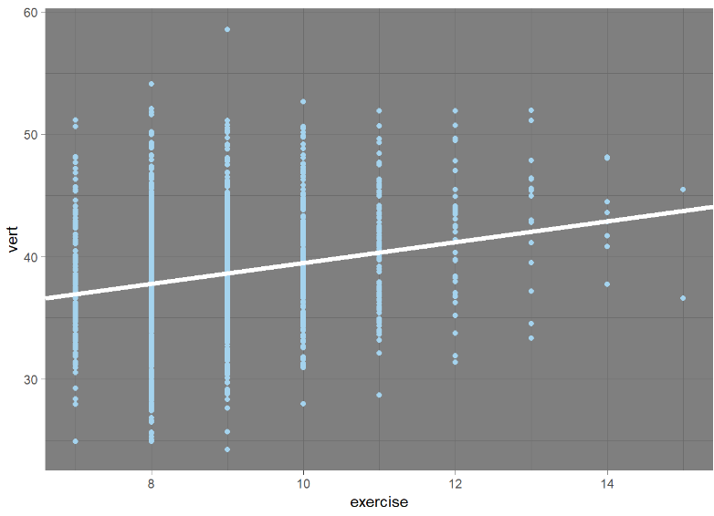
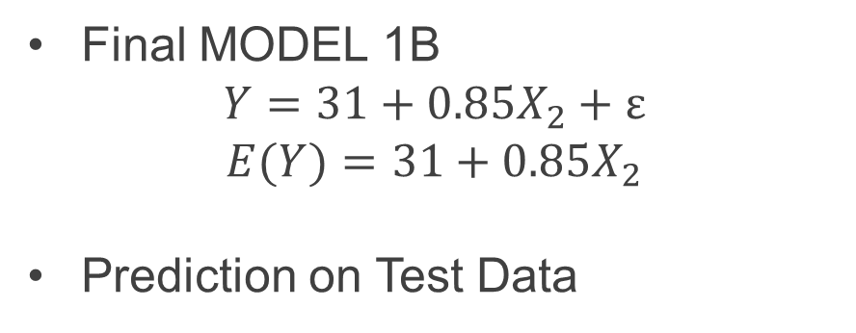
Linear Regression (MODEL 1A & 1B)
Final MODEL 1B
$$Y=31+0.85X_{2}+ε$$
$$E(Y)=31+0.85X_{2}$$
Prediction on Test Data

Slide 30
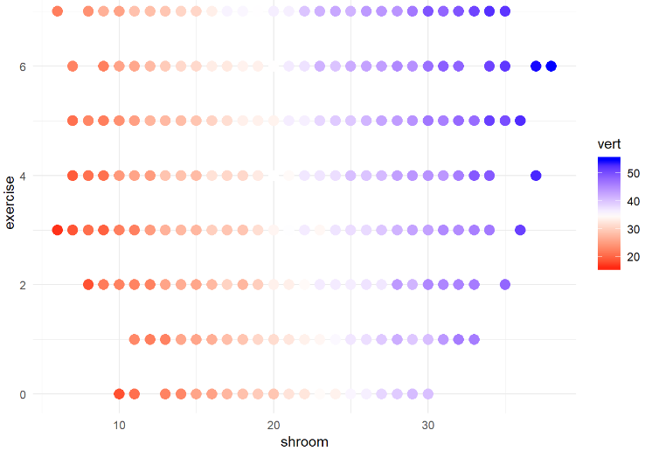
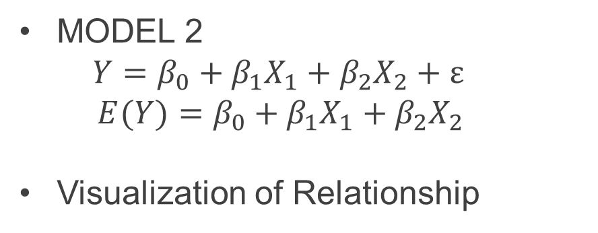
Multiple Regression (MODEL 2)
MODEL 2
$$Y=β_{0}+β_{1}X_{1}+β_{2}X_{2}+ε$$
$E(Y)=β_{0}+β_{1}X_{1}+β_{2}X_{2}$
Visualization of Relationship

Slide 31
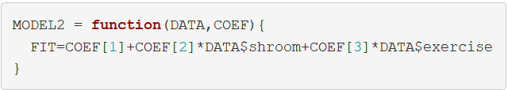
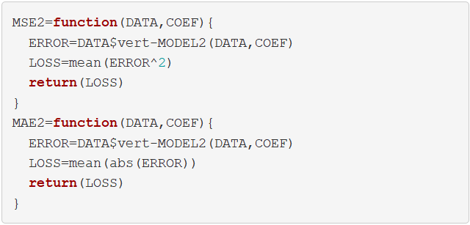
Multiple Regression (MODEL 2)
Function to Get Fitted Values
Functions to Evaluate Model

Slide 32
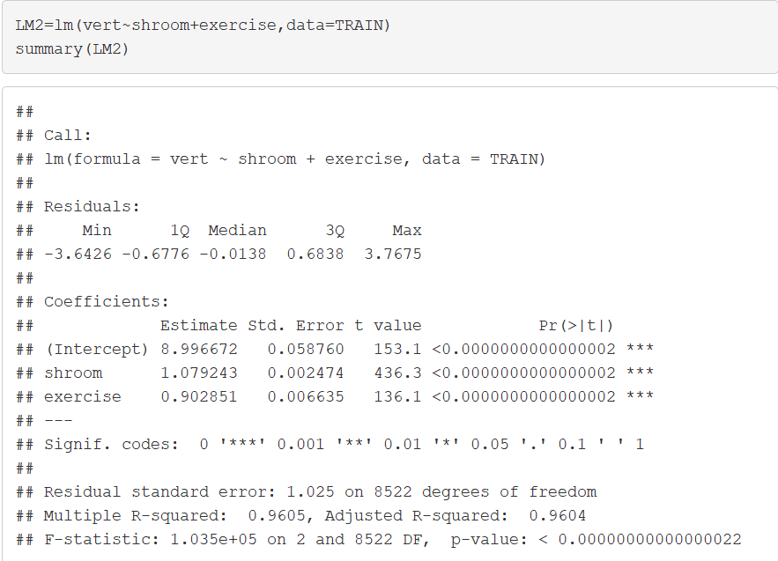

Multiple Regression (MODEL 2)
Use lm() with summary()
Final MODEL 2
$$Y=9+1.07X_{1}+0.9X_{2}+ε$$
$E(Y)=9+1.07X_{1}+0.9X_{2}$

Slide 33

Multiple Regression (MODEL 2)
Comparing Predicted Values to Actual Values for MODEL 2

Slide 34

Model Evaluation
Out-of-Sample Evaluation
Miss Universe

Slide 35


Da Truth
Simulation Facts
Noise Variation
$$σ_{noise}^{2}=1$$
Signal Variation
$σ_{signal}^{2}=26.5225−1=25.5225$
Optimal R²
$R^{2}=\frac{25.5225}{26.5225}=0.96=96\%$
$$Y=9+1.07X_{1}+0.9X_{2}+ε$$
$E(Y)=8+1.08X_{1}+0.9X_{2}$
$$ε\sim N(μ=0,σ^{2}=1)$$
$$σ_{y}^{2}={5.15}^{2}=26.5225$$

Slide 36
Closing
Disperse and Make Reasonable Decisions

